Slide 1
Case study Media Publication

Slide 2
Introduction
There are 2 leading Media Publication Brands competing with each other for attracting audiences and advertisements. A neutral agency compiles the month-wise Advertisement Volume of both these Publications (namely, Player 1 & Player 2). A detailed study and analysis of the data is provided.

Slide 3
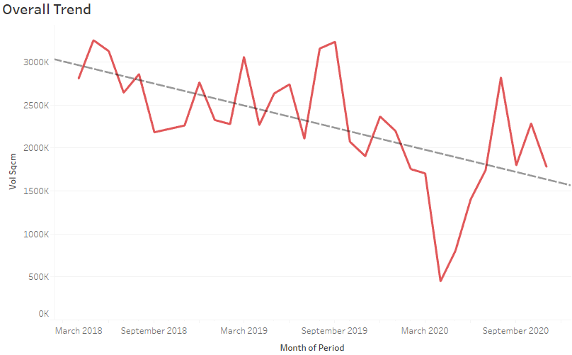
Problem-1
From the above overall trend chart, it is quite evident that there has been a downward trend in overall publication advertisement year-on year.

Slide 4
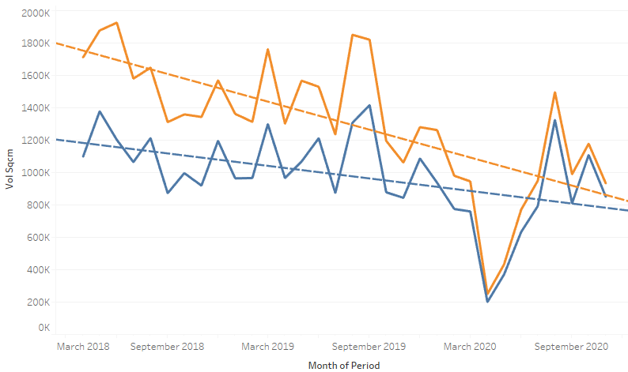

Once we take a closer look, we can see that the downward trend has been much more significant for Player 2 when compared with Player 1

Slide 5
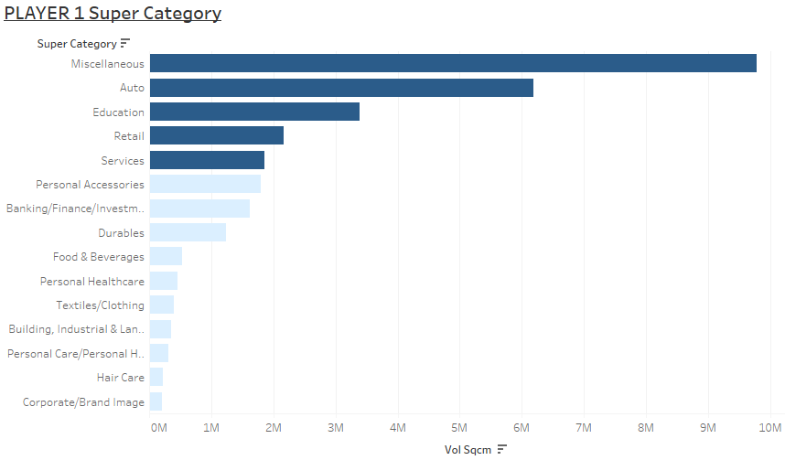
Problem - 2
Top 5 performance of Player 1 are in the following Super Categories – Miscellaneous, Auto, Education, Retail, Services and Personal Accessories.

Slide 6
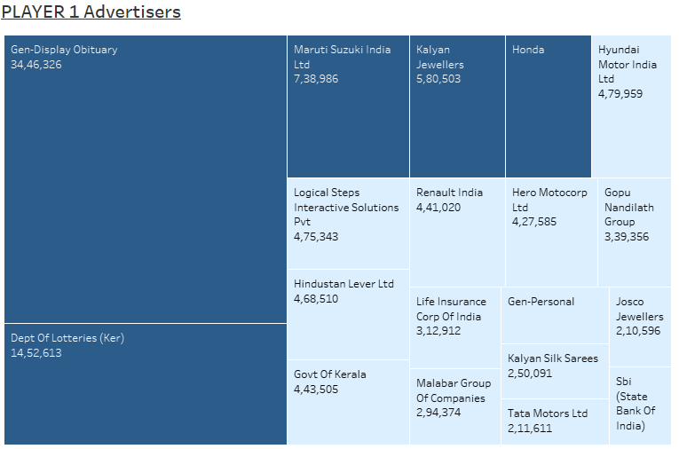
Major advertisers for Player 1 are Gen-Obituary, Dept of Lotteries, Maruthi Suzuki, Kalyan Jwellers, Honda etc.

Slide 7
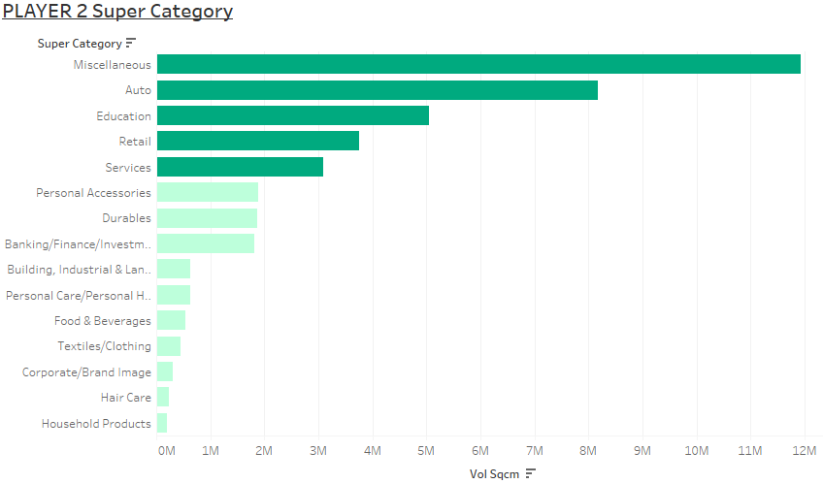
Top 5 performance of Player 2 are also in the following Super Categories – Miscellaneous, Auto, Education, Retail, Services and Personal Accessories.

Slide 8
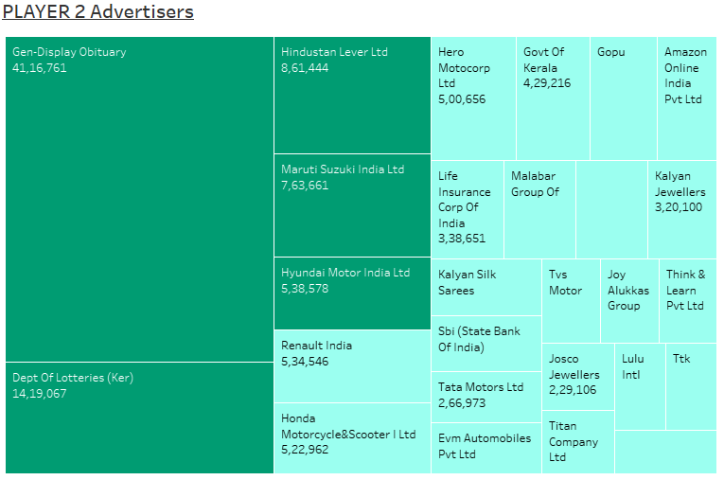
Major advertisers for Player 2 are Gen-Obituary, Dept of Lotteries, Hindustan Lever Ltd, Maruthi Suzuki, Hyundai Moror etc.

Slide 9
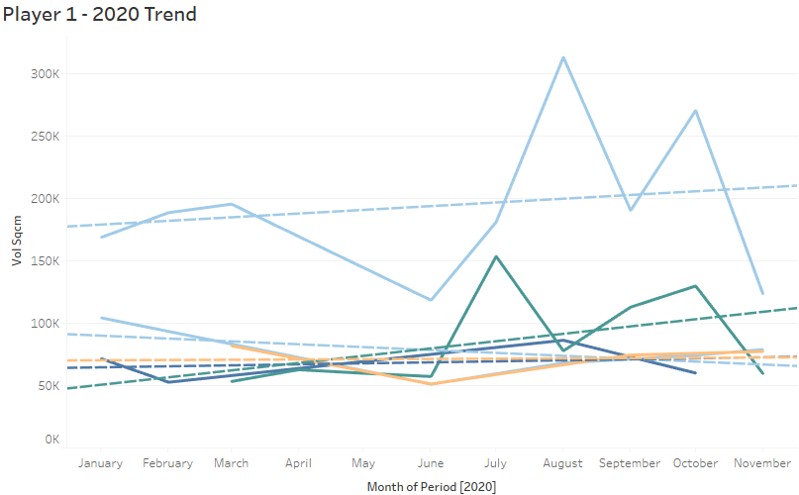
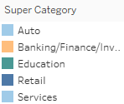
Problem-3
From the 2020 trend line of Player 1, we can see that there has been an upward trend in the Auto and Education industry. So they should try to target their marketing in those 2 industry.

Slide 10
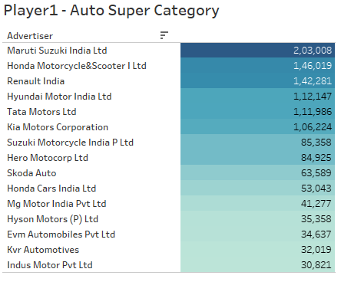
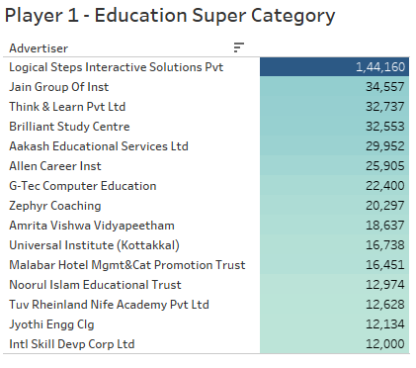
By taking a deeper look into the Auto and Education industries, these are some of the companies which has to be targeted by the sales and marketing team in order to achieve significant growth going forward.

Slide 11
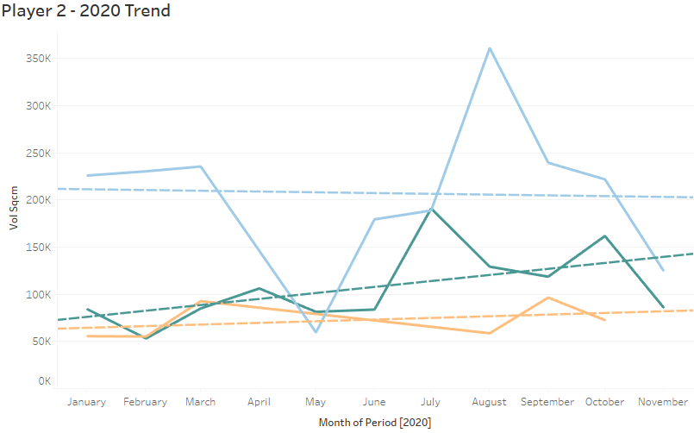

From the 2020 trend line of Player 2, we can see that there has been an upward trend in the Banking and Education industry. So they should try to target their marketing in those 2 industry.

Slide 12
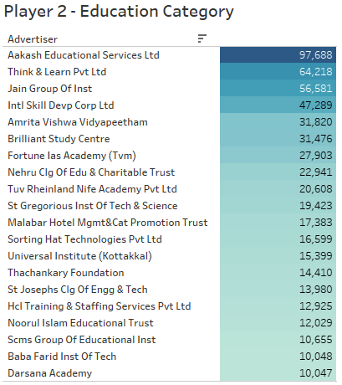
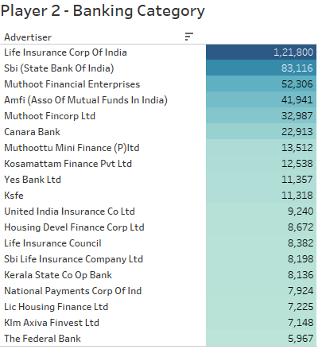
By taking a deeper look into the Banking and Education industries, these are some of the companies which has to be targeted by the sales and marketing team in order to achieve significant growth going forward.

Slide 13
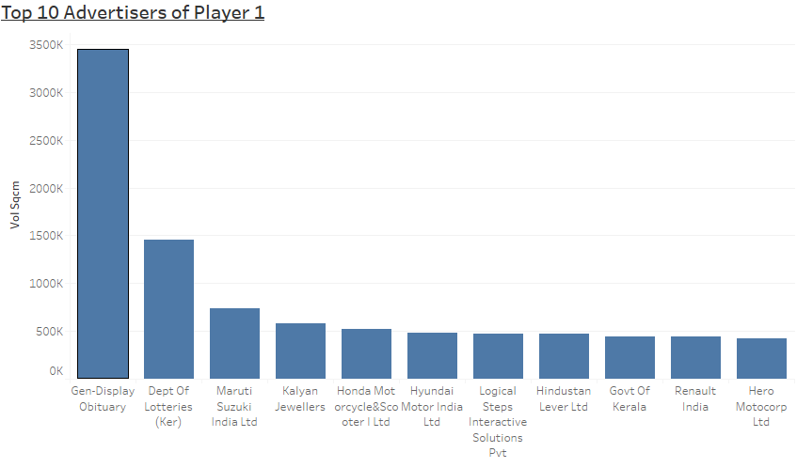
Problem-4
Top 10 advertisers of Player 1 which provide extended support are Dept of Lotteries Kerala, Maruthi Suzuki, Kalyan Jwellers, Honda Motorcycle, Hyundai Motors, Logical Steps, Hindustan Levers ltd, Govt of Kerala, Renault India, Hero Motocorp as these companies or firm has provided large volume of advertisements over the period of last 2-3 years.

Slide 14
Thank you

